Slide 1
STATG019 – Selected Topics in Statistics 2015 Lecture 5
Unsupervised Kernel Methods
Dr Franz J. Király

Slide 2
Course disorganization
In-Course-Assessment
…

Slide 3
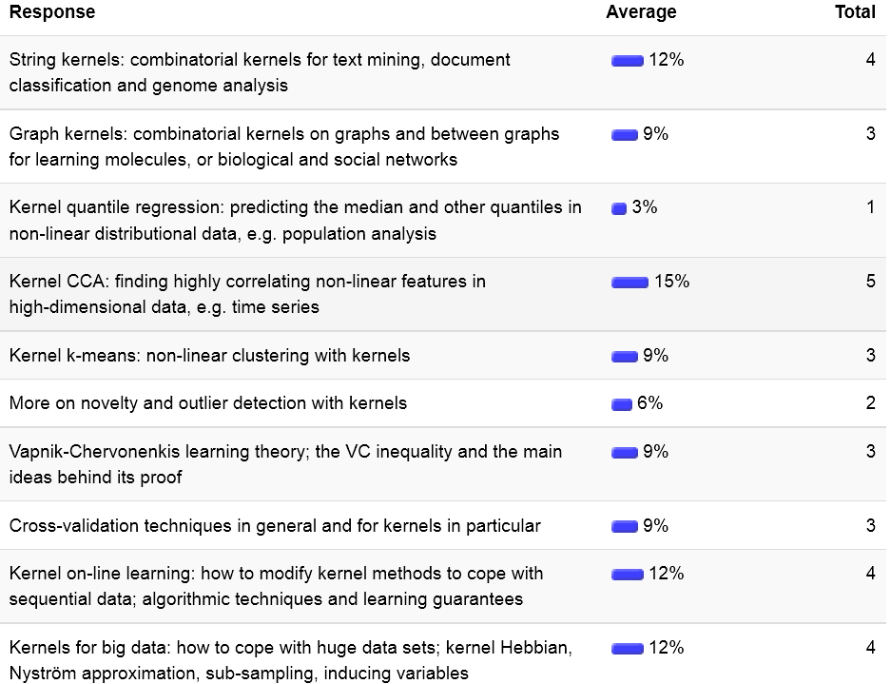
Today

Slide 4
Kernel Canonical Correlation Analysis

Slide 5
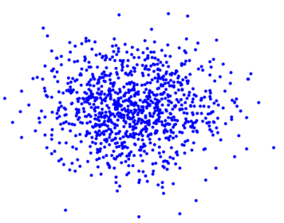
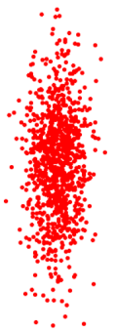



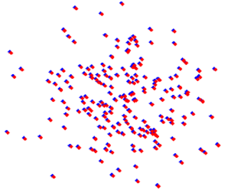
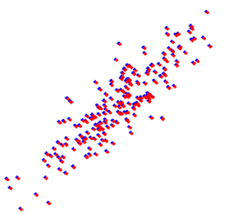

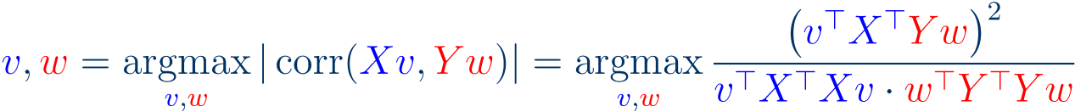




Canonical Correlation Analysis
(Hotelling, 1936)
Input:
unsupervised:
but as two equitable classes of covariates
)
(for readability assume centered data,
Output:
Linear features from both covariate classes
2D projections of the 4D data
with high correlation between each other
features
Mathematically:
coordinates
maximizing correlation between
bad: uncorrelated
good: correlated
Remarks:
Good idea:
Better idea:
Yields quadratic program (quadratically constrained):
s.t.

Slide 6





Canonical Correlation Analysis
(Hotelling, 1936)
Input:
unsupervised:
but as two equitable classes of covariates
Output:
coordinates
maximizing correlation between
2D projections of the 4D data
Quadratic program (quadratically constrained):
features
s.t.
Solution by the Lagrangian approach:
good: correlated
for extremum
(program is smooth, so no boundary cases)
computation implies:
generalized eigenvalue problem
can be efficiently solved

Slide 7







Canonical Correlation Analysis
Input:
Output:
coordinates
maximizing correlation between
Generalized eigenvalue problem
2D projections of the 4D data
features
Observe:
good: correlated
other left/right singular vectors: “canonical components”
Kernelization:
from properties of the pseudo-inverse (see lecture 4):
… does not work since assumption

Slide 8








Kernel Canonical Correlation Analysis
(Akaho, 2001)
(Fyfe, Lai, 2001)
Input:
Output:
coordinates
maximizing correlation between
Kernelization:
use that
(representer thm)
thus
from properties of pseudo-inverse:
yields:
Shrinkage regularization:
this maximizes
eigenvalue problem:
Temporal kernel CCA:
(Bießmann et al, 2009)
“canonical correlogram”

Slide 9
Kernel k-means

Slide 10
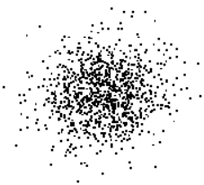
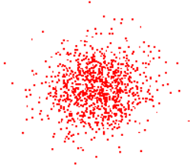
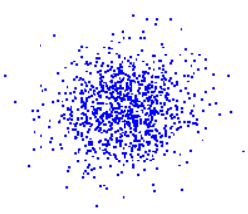
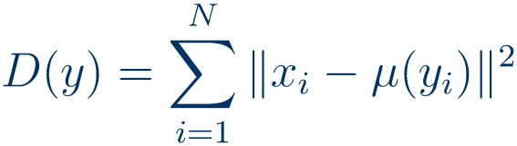

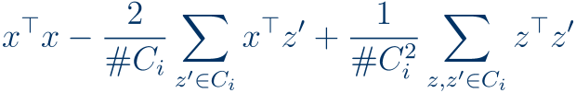

K-means clustering
(Steinhaus, 1957)
Input:
(unlabelled)
Output:
(this is the “K”)
Main idea:
cluster label = “color” of closest cluster mean
Algorithmic idea:
double iteration (EM-type)
cluster
assignment
1.
closest cluster mean color
2.
recompute
(plus various initialization strategies)
Good news:
converges, since every step decreases
non-negative loss
Sort-of-good news:
(Aloise, 2009)
Bad news:
in general to a local minimum
Doing notably better is NP-hard
Reformulation as single-step iteration:
allows (1.) without explicit computation of means (2.)
Directly Kernelizable

Slide 11

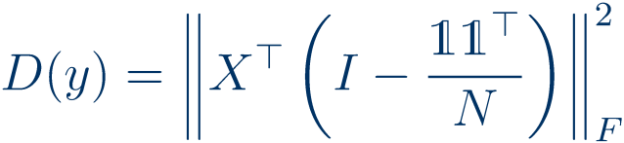
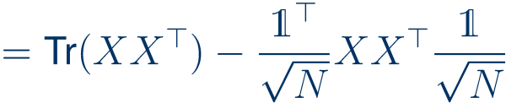











Spectral relaxation
(Dhillon et al, 2004)
Input:
Output:
K-means loss:
if there was only one cluster:
in general,
Observation:
Relaxation:
(as defined above)
Then
Relation to other clustering/unsupervised learning algorithms:
weighted spectral K-means
normalized cut/spectral clustering

Slide 12
THE END
(of kernels)

Slide 13
